Slide 1
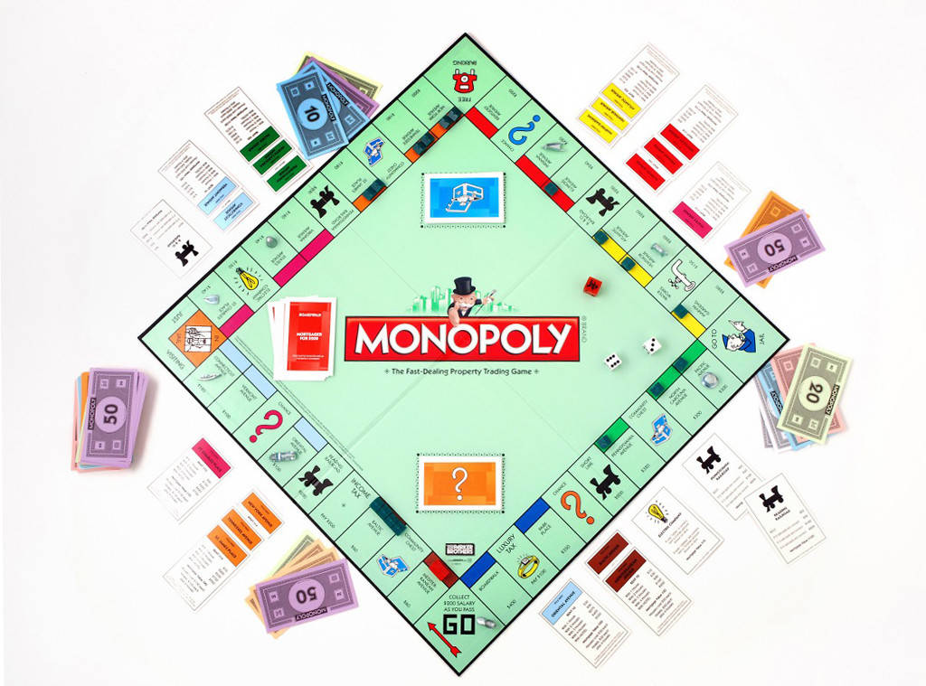
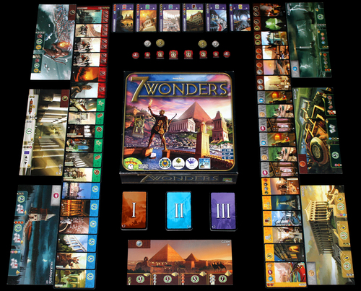
Game Design Analysis
Monopoly bad rated board game 7 Wonders good rated board game

Slide 2
Basic Information
Monopoly
7 Wonders
Who is the publisher?
Parker Brothers / HasBro
Who is the game’s designer?
Elizabeth Magie
Charles Darrow
What date did you play the game?
November 2017
With who did you play the game with?
I played with friends and family up to 6 players
Who is the publisher?
Repos Production &
Who is the game’s designer?
Antoine Bauza
What date did you play the game?
September 2017
With who did you play the game with?
With random strangers
Notes:
Repos Production
ADC Blackfire Entertainment
Asmodee
Asterion Press
Galápagos Jogos
Gém Klub Kft.
Hobby Japan
Kaissa Chess & Games
Lautapelit.fi Lifestyle Boardgames Ltd
Rebel

Slide 3
Game Classification
Monopoly
7 Wonders
Narrative is not a fundamental part of the game system and has very low impact
Very abstract
It tries to mimic the real world system but for me it does fail in it.
Narrative is not a fundamental part of the game system and has very low impact
Very abstract
It does not try to mimic real world system
Notes:
Repos Production
ADC Blackfire Entertainment
Asmodee
Asterion Press
Galápagos Jogos
Gém Klub Kft.
Hobby Japan
Kaissa Chess & Games
Lautapelit.fi Lifestyle Boardgames Ltd
Rebel

Slide 4
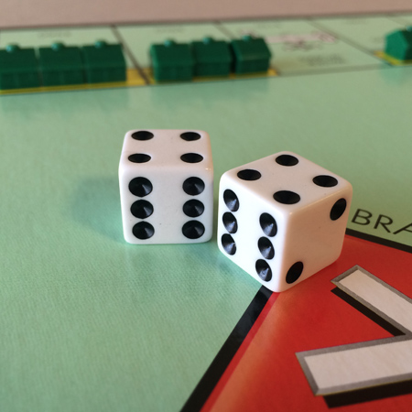
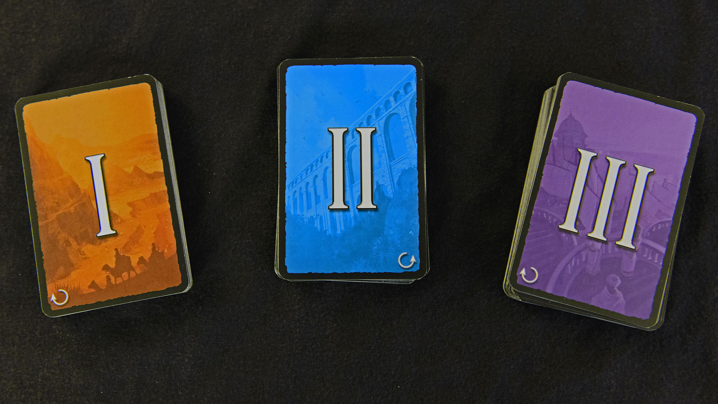
Game Classification
Monopoly
7 Wonders
The random chance is very high, to a point that it is just chance.
It’s a board/card game that is physical
There is random chance, but you still have the ability to chose between the cards you get from draft picking
It’s a board/card game that is physical

Slide 5
Game Dissection
Monopoly
7 Wonders
In monopoly the player can chose if he want to buy a land mark or not. Buying it can help the player or become an obstacle for another. If you chooses not to buy a land mark then he allows other players to offer money to the bank to buy it themselves.
You keep playing for the change to get the landmark you need and trying to bankrupt others.
The goal of the game is to own so as much money and land marks to bankrupt your opponents
Each turn a player can chose 1 card of a pile cards, this continues until all the piles are evenly distributed. While choosing a card you can see which color/ sort cards are already taken, because of that you could ignore those cards and try to counter it by picking cards specific for your neighbor.
Because there are different ways of winning, you want to continue and see if you can make it.
The goal of the game is to have the most points in the game.

Slide 6
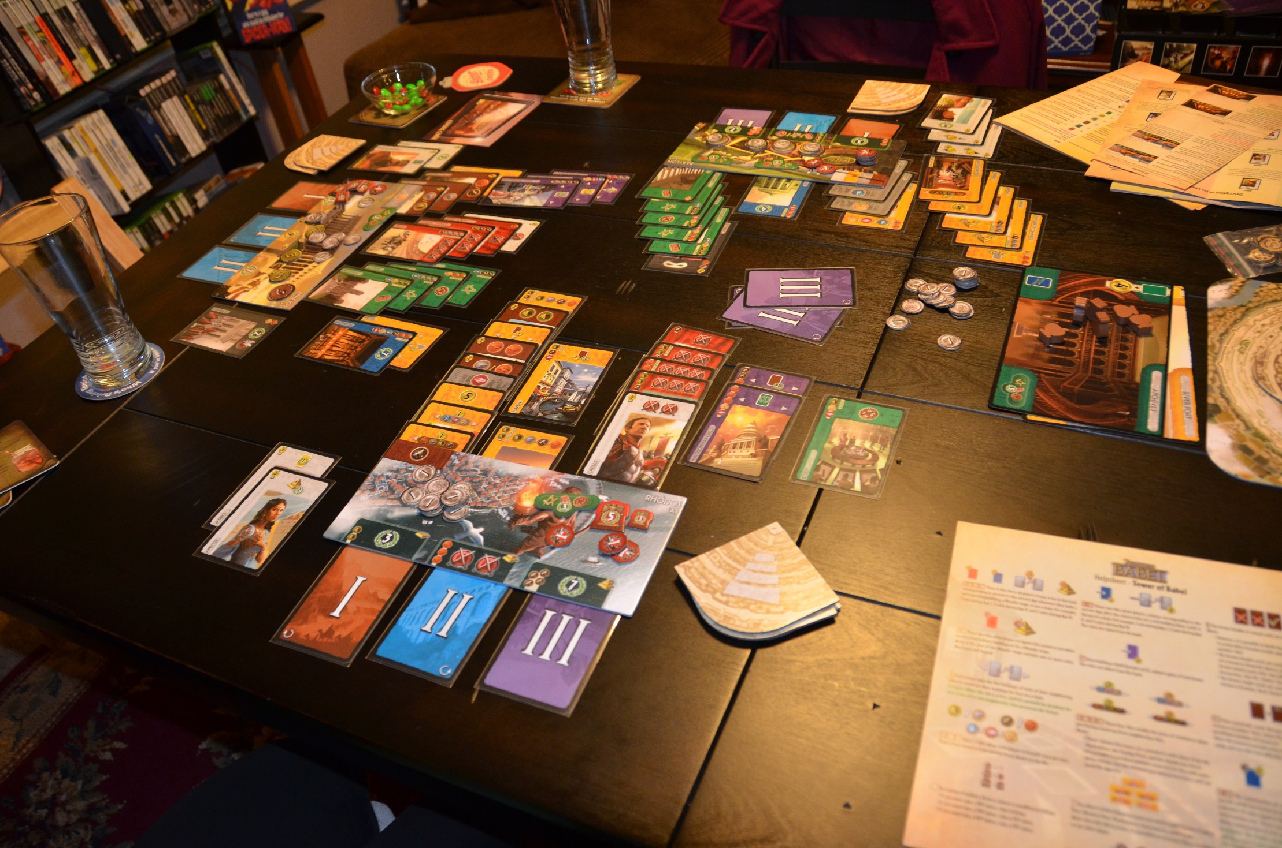
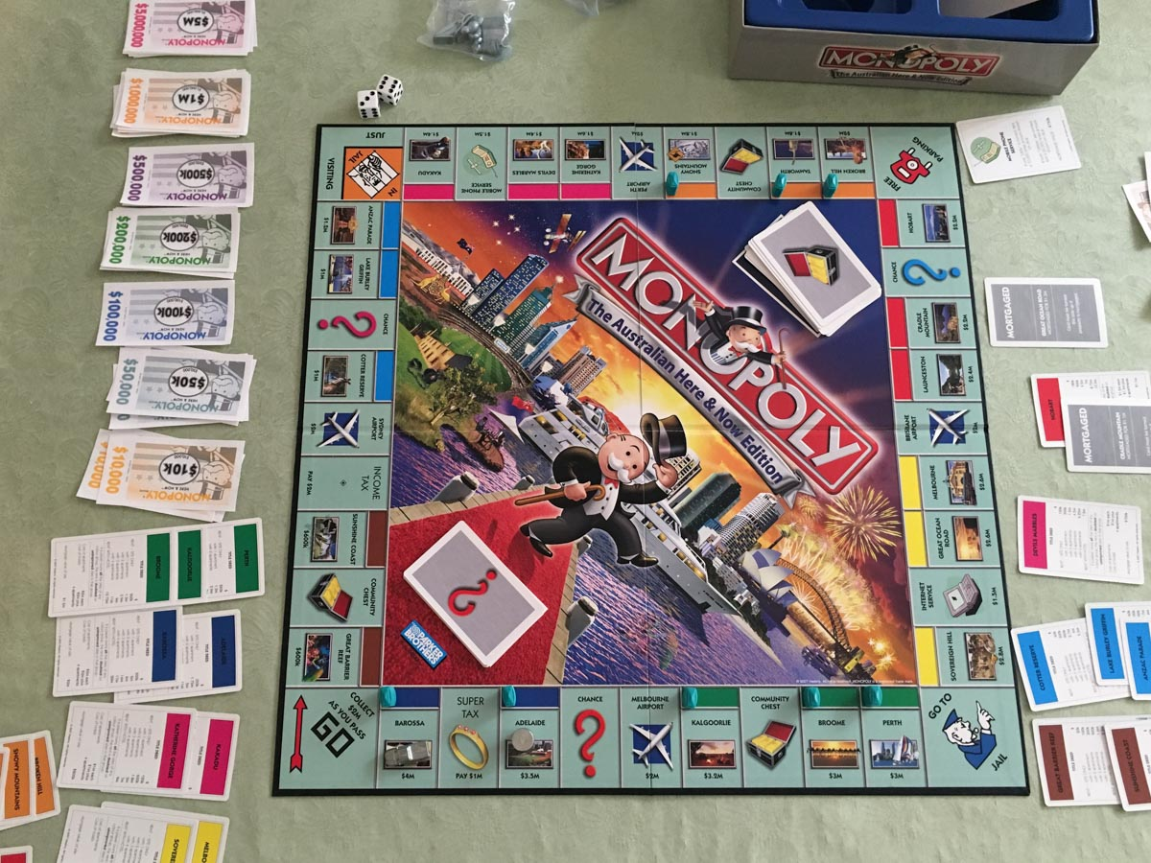
Game Dissection
Monopoly
7 Wonders
Patience and own irritation to RNG is the only challenge in this game
The more money you have, the more you can buy/build. This creates more money. When other player can’t pay you when he/she gets on your land mark, that player gets eliminated. Until only 1 player is left.
Anticipating other players and making the right choices.
Because it is a draft game of 3 sets, you can easy determine the progress of the game.

Slide 7
Game Dissection
Monopoly
7 Wonders
The theme is the domination of a market by a single entity (capitalism).
The game shows that by getting richer and richer, while the poor getting poorer.
You can pretty much play the game without the narrative story.
Monopoly is a board game where players roll two six-sided dice to move around the game-board buying and trading properties, and develop them with houses and hotels. Players collect rent from their opponents, with the goal being to drive them into bankruptcy.
7 Wonders is a dedicated deck card game that features ancient civilizations.
Because of the theme you understand the cards much faster
You can pretty much play the game without the narrative story.
In 7 wonders you pick each age a card from the draft picking. If you can pay for the cards you can play it or you need to trade with your neighbors

Slide 8
Game Dissection
Monopoly
7 Wonders
For monopoly you need dice, land marks, the game board, houses and hotels, money and the pawns.
The game is for 8 years and older
For me personally I think that this game is played at best with the same age group. I have seen and watched games played with different age groups, here the older players often tried to fool the younger players so that they could get the most out of the deals.
For 7 wonders you need the age cards and your own civilization board. The military points and money can be done on paper like the victory points at the end.
The game is for 10 years and older
For me it would be 13/15 and up. Because then you can better understand how to counter other players.

Slide 9
Game Dissection
Monopoly
7 Wonders
It can be played from 2 to 8 players
Not balanced when played by different age group, because older people can fool the younger kids
Best played with the same age groups
Gender neutral game
Might be seen as a boys board game
It can be played from 3 to 7 players
Not balanced when played by different age group, because the younger players might not understand how to counter play other players
Best played with the same age groups
Gender neutral game

Slide 10
Game Dissection
Monopoly
7 Wonders
When you share your experience you will talk about your best game that you won.
Different ways to communicate so you can find playing partners
Got introduced to it by family
When you share your experience you will talk about your choices and why you did
Different ways to communicate so you can find playing partners
Got introduced to it by family

Slide 11
Game Articulation
Monopoly
7 Wonders
Bankrupting other players you win the game
The game takes 1 to 2 hours, if players are willing to trade. I have played games longer than 3 hours.
The game is not influenced by time
The game can be played everywhere if you have enough space for the board and the people that want to play it.
The special area is the board it self
Having the most victory points at the end of 3 ages you win the game
The game takes 30/45 minutes
The game is not influenced by time
The game can be played everywhere in an open space/table because it’s actually a card game, you don’t need much space
The board had no special area

Slide 12
Game Articulation
Monopoly
7 Wonders
Elements that are required to play game
1 gameboard
10 playing tokens (including 2 spares)
28 Title Deed cards
16 Chance cards
16 Community Chest cards
1 pack of MONOPOLY money
32 Houses
12 Hotels
2 dice
Elements that directly represent the player’s agency
the choice buy or sell stuff.
Elements that are required to play game
Civilization boards
Age 1/2/3 cards
Elements that directly represent the player’s agency
Civilization board and the draft picking

Slide 13
Game Articulation
Monopoly
7 Wonders
The lesser players can pay rent the closer you are to end game
In Monopoly, each property on the board can be considered an object with a dynamic “number of houses” attribute with six states (0, 1, 2, 3, 4, hotel), and a “mortgaged” attribute with two states
After throwing the dice and moved your pawn, you can chose to buy something or sell it, of course if that landmark is not already taken.
The number of age the players are in shows the end state of the game
Gold, military points and age cards are the elements in 7 wonders
Picking 1 card each turn from the draft cards is the core of the game.

Slide 14
Game Articulation
Monopoly
7 Wonders
Money determines progression
The system rules create explicit social rules
Trading influence social behaviors
Paying and trading with players is an explicit social rule.
At the end of each age you solve the conflicts and continue to the next age. At the end of age 3 you sole the last conflicts. After that you count all the points
The system rules create explicit social rules
Age card sometimes need resources to be build that influence social behaviors
The need of resources create implicit social behavior

Slide 15
Game Articulation
Monopoly
7 Wonders
Without interaction you cant play the game. You need to buy from each other or the game can end being stuck and take forever.
Some decisions have medium impact in the game and are not interesting
You have medium interest for pursuing a goal
You can almost not react to other players
You can play without interacting with other players, but sometimes when you cant pay for some buildings you are forced to interact.
Some decisions have medium impact in the game and can be interesting because of draft pick
You have medium interest for pursuing a goal
You can react to other players

Slide 16
Game Articulation
Monopoly
7 Wonders
Almost no choices in a game
Never change your end goal
Very clear when you need to take action
Easy to understand
Every draft pick you make a choice
You can always change your winning goal
Very clear when you need to take action
Easy to understand

Slide 17
Gameplay Experience
Monopoly
7 Wonders
You need to be able to throw a dice, read a card and understand how to buy and sell
To play you need language to read, attention, able to count, motor skills and hearing
For me the game does not help you want to play more. It is the players own greed and hope that thinks you might win
You need to be able to see and make decisions based on your cards
To play you need language, attention, ability to think ahead and able to count
1 game is very sort and because of the colors on the age cards, you see and understand that you drawing close to the end game.

Slide 18
Gameplay Experience
Monopoly
7 Wonders
Almost no anticipation chance
Almost no surprise element
Almost no pleasure, unless you are winning
Easy to master
Almost no control
high composure
Medium anticipation chance
Medium surprise element
From begin to end high pleasure
Easy to learn takes time to master
Good feeling of control
Medium composure

